Slide 1
Soldering station
Luyts Thibault
1EAIa

Slide 2
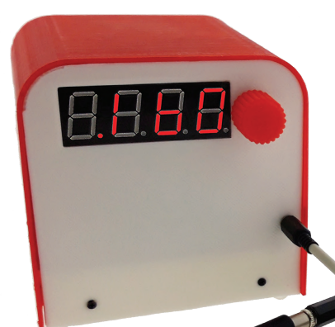
What is a soldering station?

Slide 3
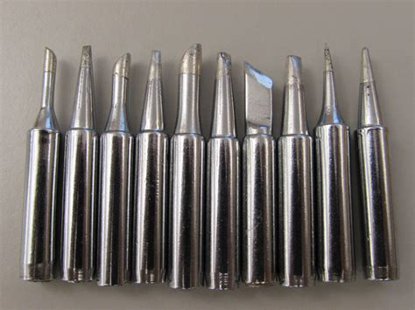
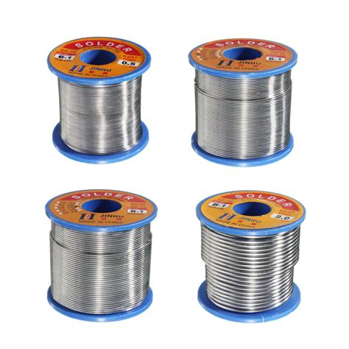
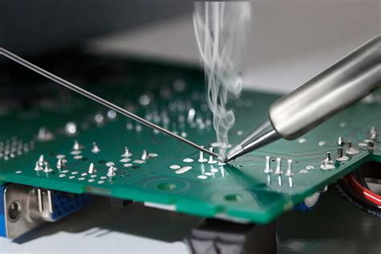
What is soldering?
Material
tool
Soldering
Tips
station

Slide 4
Characteristics and reasons of making this
Small/compact
Known components
Usefull
Field
Everyone

Slide 5
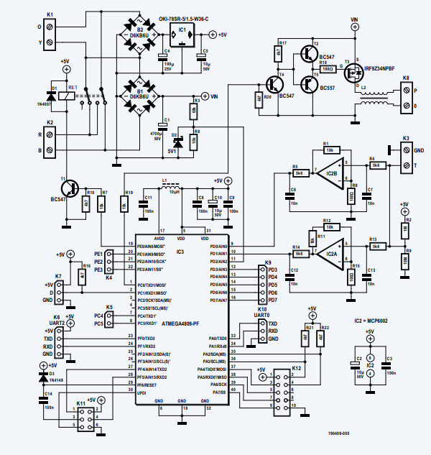
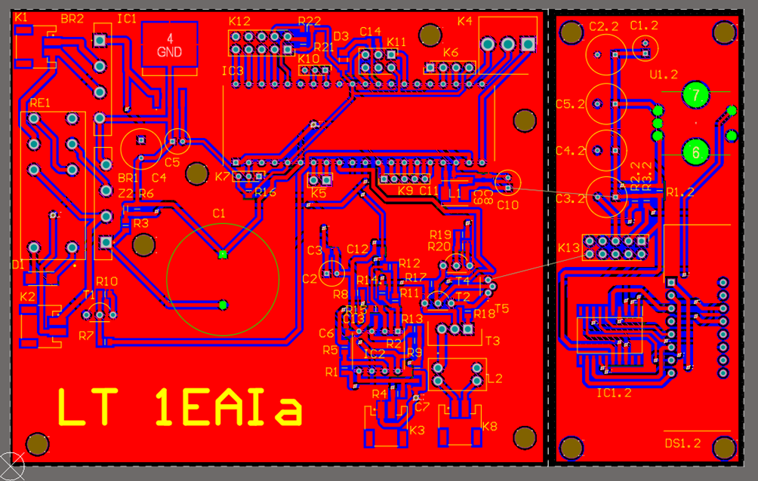
The end Result
Start
Changes
PCB design
Case
PCB board

Slide 6
Now that everything is made
(sort of)
Experience
Tools
Fun
Components
Case work

Slide 7
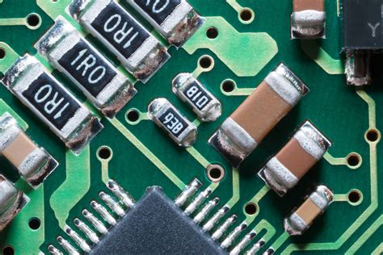
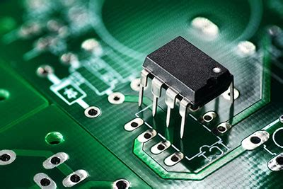
What do I have left to do?
SMD
TH components
Testing
Case fiting

Slide 8
Any Questions?

